Slide 1
JAVA
UNIT 9

Slide 2
Java I/O
Java I/O (Input and Output) is used to process the input and produce the output.
Java uses the concept of a stream to make I/O operation fast. The java.io package contains all the classes required for input and output operations.
We can perform file handling in Java by Java I/O API.

Slide 3
Stream
A stream is a sequence of data. In Java, a stream is composed of bytes. It's called a stream because it is like a stream of water that continues to flow.
In Java, 3 streams are created for us automatically. All these streams are attached with the console.
1) System.out: standard output stream
2) System.in: standard input stream
3) System.err: standard error stream

Slide 4
Read input from console
Using Buffered Reader Class
Using Scanner Class
Using Console Class

Slide 5
Using Scanner Class
The main purpose of the Scanner class is to read input from the user in the command line.
Advantages:
Convenient methods for parsing primitives (nextInt(), nextFloat(), …) from the tokenized input.
https://www.geeksforgeeks.org/scanner-class-in-java/

Slide 6
Writing console output
For console output, we can use System.out — an instance of the PrintStream class, which is a type of OutputStream.
In our example, we'll use console output to provide a prompt for user input and display a final message to a user.
Let's use the println() method to print a String and terminate the line:
System.out.println("Please enter your name ");
Alternately, we can use the print() method, which works similarly to println(), but without terminating the line.

Slide 7
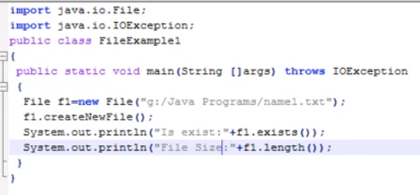
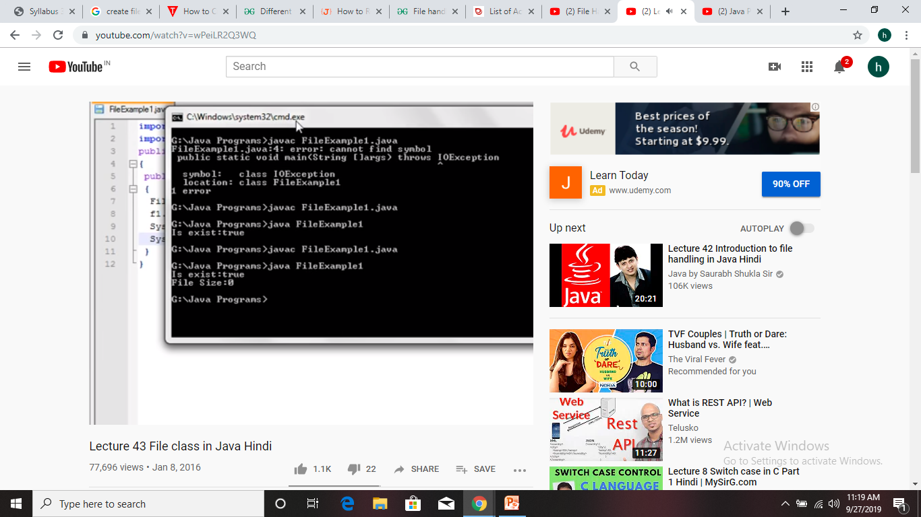
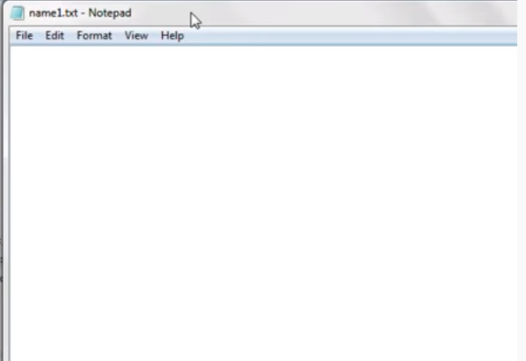
How to Create a File

Slide 8
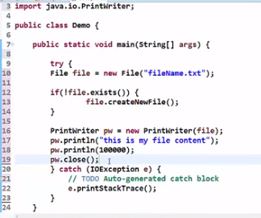
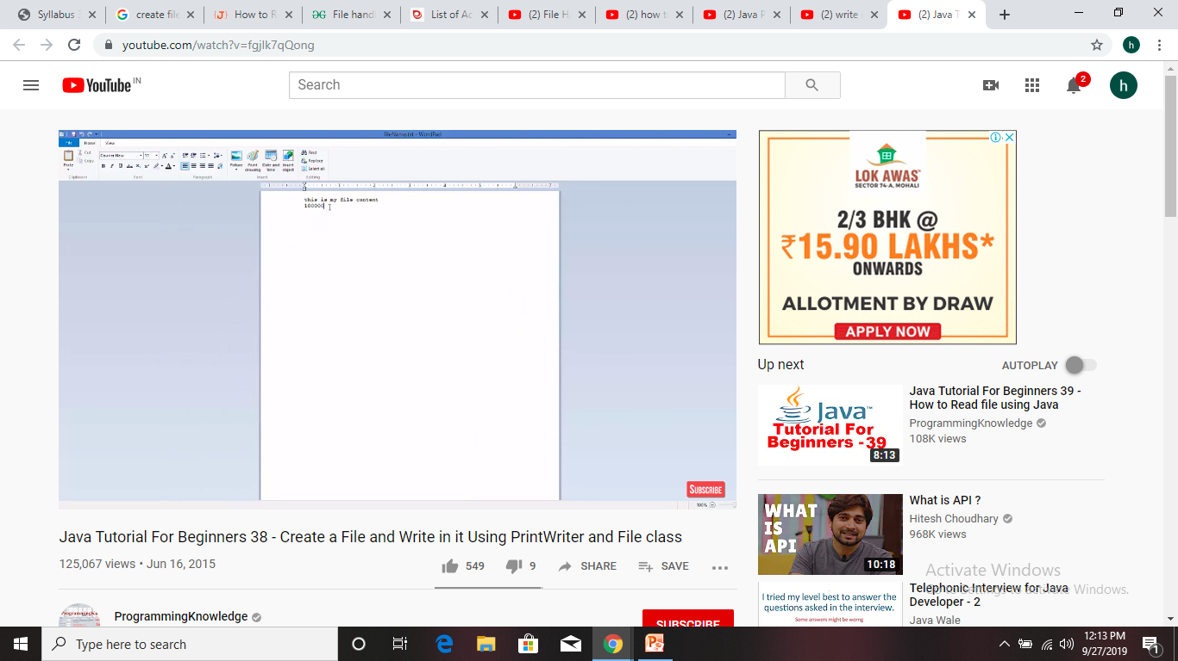
Write in file using PrintWriter class

Slide 9
PrintWriter class
https://www.javatpoint.com/java-printwriter-class
Note: flush() writes the content of the buffer to the destination and makes the buffer empty for further data to store but it does not closes the stream permanently. That means you can still write some more data to the stream.
But close() closes the stream permanently. If you want to write some data further, then you have to reopen the stream again and append the data with the existing ones.

Slide 10
Read java file
FileReader is useful to read data in the form of characters from a ‘text’ file.
import java.io.FileNotFoundException;
import java.io.FileReader;
import java.io.IOException;
class ReadFile
{ public static void main(String[] args) throws IOException
{ int ch;
// check if File exists or not
try
{ FileReader fr = new FileReader("text");
}
catch (FileNotFoundException fe)
{
System.out.println("File not found");
}
// read from FileReader till the end of file
while ((ch=fr.read())!=-1)
System.out.print((char)ch);
// close the file
fr.close(); } }

